Slide 1

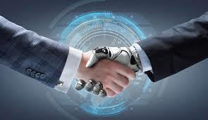
INTRODUCTION TO
ARTIFICIAL INTELLIGENCE

Slide 2
INTRODUCTION
AI is one of the newest disciplines, formally initiated in 1956 when the name was coined. However, the study of intelligence is one of the oldest disciplines being approximately 2000 years old. The advent of computers made it possible for the first time for people to test models they proposed for learning, reasoning, perceiving, etc.
Artificial Intelligence is composed of two words Artificial and Intelligence, where Artificial defines "man- made," and intelligence defines "thinking power", hence AI means "a man-made thinking power."
WHAT IS ARTIFICIAL INTELLIGENCE?
Artificial intelligence is the simulation of human intelligence processes by machines, especially computer systems. Specific applications of AI include expert systems, natural language processing, speech recognition and machine vision.

Slide 3
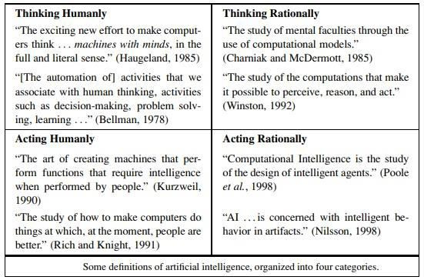

Slide 4
ACTING HUMANLY
A human interrogates the program and another human via a terminal simultaneously. If after a reasonable period, the interrogator cannot tell which is which, the program passes.
To pass this test requires:
Natural language processing
This test avoids physical contact and concentrates on
Knowledge representation
"higher level" mental faculties. A total Turing test
Automated reasoning
would require the program to also do:
Machine learning
Computer vision
Robotics

Slide 5
THINKING HUMANLY
This requires "getting inside" of the human mind to see how it works and then comparing our computer
programs to this. This is what cognitive science attempts to do.
Another way to do this is to observe a human problem solving and argue that one's programs go about
problem solving in a similar way.

Slide 6
THINKING RATIONALLY
Aristotle was one of the first to attempt to codify "thinking".
EXAMPLE: All computers use energy. Using energy always generates heat. Therefore, all computers generate heat. This initiate the field of logic. Formal logic was developed in the late nineteenth century. This was the first step toward enabling computer programs to reason logically.

Slide 7
Acting rationally means acting so as to achieve one's goals, given one's beliefs. An agent is just something
ACTING RATIONALLY / THE RATIONAL AGENT APPROACH
that perceives and acts.
In the logical approach to AI, the emphasis is on correct inferences. This is often part of being a rational agent because one way to act rationally is to reason logically and then act on ones conclusions. But this is not all of rationality because agents often find themselves in situations where there is no provably correct thing to do, yet they must do something.
There are also ways to act rationally that do not seem to involve inference, e.g., reflex actions.

Slide 8
FOUNDATIONS OF AI
Like any history, this one is forced to concentrate on a small number of people, events, and ideas and to ignore others that also were important. We organize the history around a series of questions. We certainly would not wish to give the impression that these questions are the only ones the disciplines address or that the disciplines have all been working toward AI as their ultimate fruition.
PHILOSOPHY
Can formal rules be used to draw valid conclusions?
How does the mind arise from a physical brain?
Where does knowledge come from?
How does knowledge lead to action?
Aristotle (384–322 B.C.), was the first to formulate a precise set of laws governing the rational part of the mind. He developed an informal system of syllogisms for proper reasoning, which in principle allowed one to generate conclusions mechanically, given initial premises.
Much later, Ramon Lull (d. 1315) had the idea that useful reasoning could actually be carried out by a mechanical artifact. Thomas Hobbes (1588–1679) proposed that reasoning was like numerical computation that “we add and subtract in our silent thoughts.”

Slide 9
2 MATHEMATICS
What are the formal rules to draw valid conclusions?
What can be computed?
How do we reason with uncertain information?

Slide 10
3 ECONOMICS
How should we make decisions so as to maximize payoff?
How should we do this when others may not go along?
How should we do this when the payoff may be far in the future?
4 NEUROSCIENCE
How do brains process information?
Neuroscience is the study of the nervous system, particularly the brain. Although the exact way in which the brain enables thought is one of the great mysteries of science, the fact that it does enable thought has been
appreciated for thousands of years because of the evidence that strong blows to the head can lead to mental
incapacitation.
It has also long been known that human brains are somehow different; in about 335 B.C. Aristotle wrote, “Of all the animals, man has the largest brain in proportion to his size.”5 Still, it was not until the middle of the 18th century that the brain was widely recognized as the seat of consciousness. Before then, candidate locations included the heart and the spleen.

Slide 11
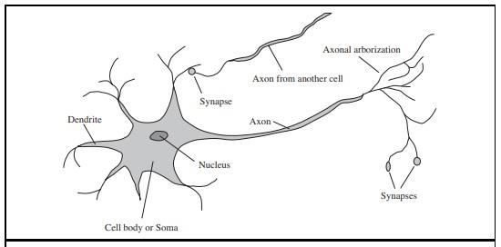
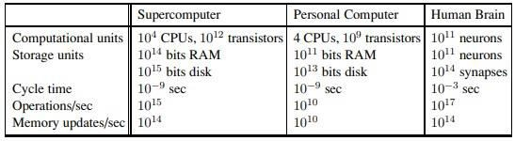
The parts of a nerve cell or neuron. Each neuron consists of a cell body, or soma, that contains a cell nucleus. Branching out from the cell body are a number of fibers called dendrites and a single long fiber called the axon. The axon stretches out for a long distance, much longer than the scale in this diagram indicates.

Slide 12
5 PSYCHOLOGY
How do humans and animals think and act?
The principle characteristic of cognitive psychology is that the brain processes and processes information. The claim is that beliefs, goals, and reasoning steps can be useful components of a theory of human behaviour. The
knowledge-based agent has three key steps:
Stimulus is translated into an internal representation
The representation is manipulated by cognitive processes to derive new internal representations These are translated into actions
6 COMPUTER ENGINEERING
How can we build an efficient computer?
For artificial intelligence to succeed, we need two things: intelligence and an artifact. The computer has been the artifact of choice. The modern digital electronic computer was invented independently and almost simultaneously by scientists in three countries embattled in World War II.

Slide 13
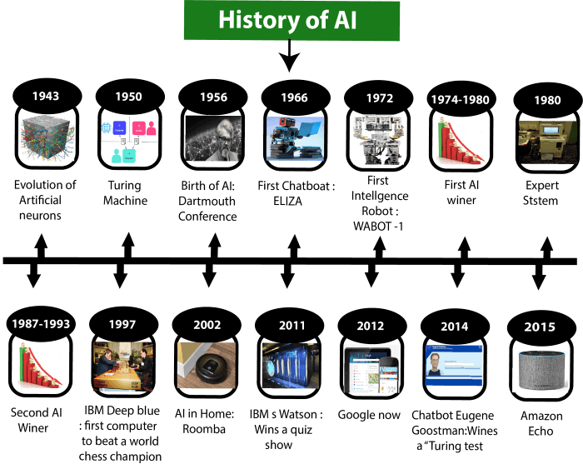
HISTORY OF ARTIFICIAL INTELLIGENCE
Artificial Intelligence is not a new word and not a new technology for researchers. This technology is much older than you would imagine. Even there are the myths of Mechanical men in Ancient Greek and Egyptian Myths. Following are some milestones in the history of AI which defines the journey from the AI generation to till date development.

Slide 14
Maturation of Artificial Intelligence (1943-1952)
Year 1943: The first work which is now recognized as AI was done by Warren McCulloch and
Walter pits in 1943. They proposed a model of artificial neurons.
Year 1949: Donald Hebb demonstrated an updating rule for modifying the connection strength
between neurons. His rule is now called Hebbian learning.
Year 1950: The Alan Turing who was an English mathematician and pioneered Machine
learning in 1950. Alan Turing publishes "Computing Machinery and Intelligence" in which he proposed a test. The test can check the machine's ability to exhibit intelligent behavior equivalent to human intelligence, called a Turing test.

Slide 15
The birth of Artificial Intelligence (1952-1956)
Year 1955: An Allen Newell and Herbert A. Simon created the "first artificial intelligence
program"Which was named as "Logic Theorist". This program had proved 38 of 52
Mathematics theorems, and find new and more elegant proofs for some theorems.
Year 1956: The word "Artificial Intelligence" first adopted by American Computer scientist
John McCarthy at the Dartmouth Conference. For the first time, AI coined as an academic field.
At that time high-level computer languages such as FORTRAN, LISP, or COBOL were
invented. And the enthusiasm for AI was very high at that time.

Slide 16
The golden years-Early enthusiasm (1956-1974)
Year 1966: The researchers emphasized developing algorithms which can solve mathematical problems. Joseph Weizenbaum created the first chatbot in 1966, which was named as ELIZA.
Year 1972: The first intelligent humanoid robot was built in Japan which was named as WABOT-1.
The first AI winter (1974-1980)
The duration between years 1974 to 1980 was the first AI winter duration. AI winter refers to the time period where computer scientist dealt with a severe shortage of funding from government for AI researches.
During AI winters, an interest of publicity on artificial intelligence was decreased.

Slide 17
A boom of AI (1980-1987)
Year 1980: After AI winter duration, AI came back with "Expert System". Expert systems were
programmed that emulate the decision-making ability of a human expert.
In the Year 1980, the first national conference of the American Association of Artificial
Intelligence was held at Stanford University.
The second AI winter (1987-1993)
The duration between the years 1987 to 1993 was the second AI Winter duration.
Again Investors and government stopped in funding for AI research as due to high cost but not
efficient result. The expert system such as XCON was very cost effective.

Slide 18
The emergence of intelligent agents (1993-2011)
Year 1997: In the year 1997, IBM Deep Blue beats world chess champion, Gary Kasparov, and became the first computer to beat a world chess champion.
Year 2002: for the first time, AI entered the home in the form of Roomba, a vacuum cleaner.
Year 2006: AI came in the Business world till the year 2006. Companies like Facebook, Twitter, and Netflix also started using AI.

Slide 19
Deep learning, big data and artificial general intelligence (2011-present)
Year 2011: In the year 2011, IBM's Watson won jeopardy, a quiz show, where it had to solve the complex questions as well as riddles. Watson had proved that it could understand natural language and can solve tricky questions quickly.
Year 2012: Google has launched an Android app feature "Google now", which was able to provide information to the user as a prediction.
Year 2014: In the year 2014, Chatbot "Eugene Goost man" won a competition in the infamous "Turing test."
Year 2018: The "Project Debater" from IBM debated on complex topics with two master debaters
and also performed extremely well.
Google has demonstrated an AI program "Duplex" which was a virtual assistant and which had taken hairdresser appointment on call, and lady on other side didn't notice that she was talking with the machine.

Slide 20
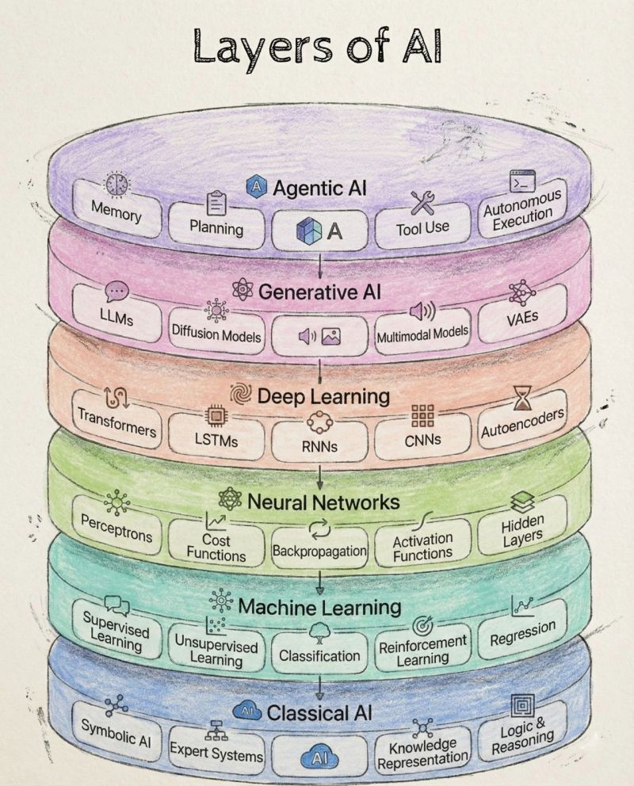

Slide 21
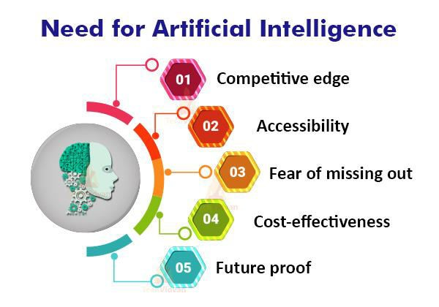

Slide 22
COMPETITIVE EDGE
The organizations which mean to have a serious edge over their adversaries are banking upon AI advancements to acquire this.
Take the case of the Autopilot highlight offered by Tesla in its vehicles. Tesla is utilizing Deep Learning Algorithms to accomplish Autonomous driving. This was before, when there was only one element out of many, yet now it is characterizing the brand.
ACCESSIBILITY
The establishment speed, availability, and sheer scale have enabled bolder computations to deal
with progressively exciting issues. Not solely is the gear faster, expanded by specific assortments of
processors (e.g., GPUs), it is moreover available looking like cloud organizations.
What used to run in explicit labs with access to super PCs would now pass on to the cloud at a lower cost. This has democratized access to the significant hardware stages to run AI, enabling duplication of new organizations.

Slide 23
FEAR OF MISSING OUT (FOMO)
No typo, you read that right! Not simply us, organizations additionally feel the dread of passing up a major opportunity. To stay competitive and not get tossed out of the market, they need to adjust appropriately. This is done by putting resources into advances that would upset their enterprises.
Take the case of the financial part, where practically all the banks have put vigorously in chatbots with
the goal that they won’t pass up the following rush of interruption.
COST-EFFECTIVENESS
As with all other technologies, with time, AI is becoming more and more affordable. This has made it feasible for a lot of organizations that couldn’t bear the cost of them in the past to use these advances.
Organizations do not have that barrier of cost to implement AI.

Slide 24
5. FUTURE PROOF
One thing that we all need to comprehend is that future in AI is very safe .
Organizations can and ought to guarantee themselves to be future confirmation by actualizing AI advancements. On the off chance that this is where the world is going, why not to head in that equivalent course and be versatile to that change.

Slide 25
WHY ARTIFICIAL INTELLIGENCE?
Before Learning about Artificial Intelligence, we should know that what is the importance of AI
and why should we learn it.
With the help of AI, you can create such software or devices which can solve real-world problems very easily and with accuracy such as health issues, marketing, traffic issues, etc.
With the help of AI, you can create your personal virtual Assistant, such as Cortana, Google Assistant, Siri, etc.
With the help of AI, you can build such Robots which can work in an environment where
survival of humans can be at risk.
AI opens a path for other new technologies, new devices, and new Opportunities.

Slide 26
GOALS OF ARTIFICIAL INTELLIGENCE
Replicate human intelligence
Solve Knowledge-intensive tasks
An intelligent connection of perception and action
Building a machine which can perform tasks that requires human intelligence such as:
Proving a theorem
Playing chess
Plan some surgical operation
Driving a car in traffic
Creating some system which can exhibit intelligent behaviour, learn new things by itself,
demonstrate, explain, and can advise to its user.

Slide 27
ADVANTAGES OF ARTIFICIAL INTELLIGENCE
High Accuracy with less errors: AI machines or systems are prone to less errors and high accuracy as it takes decisions as per pre-experience or information.
High-Speed: AI systems can be of very high-speed and fast-decision making, because of that AI systems can
beat a chess champion in the Chess game.
High reliability: AI machines are highly reliable and can perform the same action multiple times with high
accuracy.
Useful for risky areas: AI machines can be helpful in situations such as defusing a bomb, exploring the ocean floor, where to employ a human can be risky.
Digital Assistant: AI can be very useful to provide digital assistant to the users such as AI technology is
currently used by various E-commerce websites to show the products as per customer requirement.
Useful as a public utility: AI can be very useful for public utilities such as a self-driving car which can make our journey safer and hassle-free, facial recognition for security purpose, Natural language processing to communicate with the human in human-language, etc.

Slide 28
DISADVANTAGES OF ARTIFICIAL INTELLIGENCE
Every technology has some disadvantages, and the same goes for Artificial intelligence. Being so advantageous
technology still, it has some disadvantages which we need to keep in our mind while creating an AI system. Following are the disadvantages of AI:
High Cost: The hardware and software requirement of AI is very costly as it requires lots of maintenance to
meet current world requirements.
Can't think out of the box: Even we are making smarter machines with AI, but still they cannot work out of
the box, as the robot will only do that work for which they are trained, or programmed.
No feelings and emotions: AI machines can be an outstanding performer, but still it does not have the feeling so it cannot make any kind of emotional attachment with human, and may sometime be harmful for users if the
proper care is not taken.
Increase dependency on machines: With the increment of technology, people are getting more dependent on devices and hence they are losing their mental capabilities.
No Original Creativity: As humans are so creative and can imagine some new ideas but still AI machines
cannot beat this power of human intelligence and cannot be creative and imaginative.

Slide 29
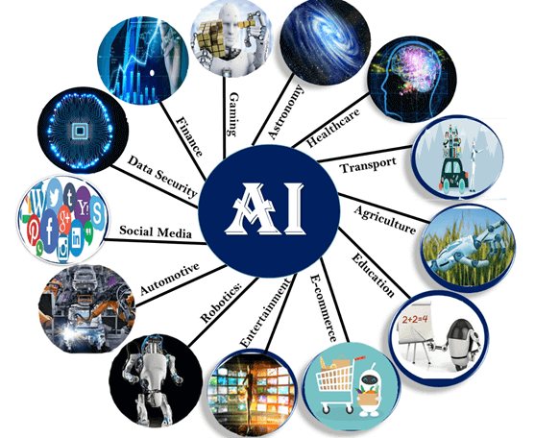
APPLICATION OF AI

Slide 30
AI in Astronomy
Artificial Intelligence can be very useful to solve complex universe problems. AI technology can be
helpful for understanding the universe such as how it works, origin, etc.
AI in Healthcare
In the last, five to ten years, AI becoming more advantageous for the healthcare industry and going to have a significant impact on this industry.
Healthcare Industries are applying AI to make a better and faster diagnosis than humans. AI can help
doctors with diagnoses and can inform when patients are worsening so that medical help can reach to
the patient before hospitalization.
AI in Gaming
AI can be used for gaming purpose. The AI machines can play strategic games like chess, where the machine needs to think of a large number of possible places.

Slide 31
AI in Finance
AI and finance industries are the best matches for each other. The finance industry is implementing automation, chatbot, adaptive intelligence, algorithm trading, and machine learning into financial processes.
AI in Data Security
The security of data is crucial for every company and cyber-attacks are growing very rapidly in the
digital world. AI can be used to make your data more safe and secure. Some examples such as AEG bot, AI2 Platform,are used to determine software bug and cyber-attacks in a better way.
AI in Social Media
Social Media sites such as Facebook, Twitter, and Snapchat contain billions of user profiles, which need to be stored and managed in a very efficient way. AI can organize and manage massive amounts of data. AI can analyze lots of data to identify the latest trends, hashtag, and requirement of different users.

Slide 32
AI in Travel & Transport
AI is becoming highly demanding for travel industries. AI is capable of doing various travel related works such as from making travel arrangement to suggesting the hotels, flights, and best routes to the customers. Travel industries are using AI-powered chatbots which can make human-like interaction with customers for better and fast response.
AI in Automotive Industry
Some Automotive industries are using AI to provide virtual assistant to their user for better performance. Such as Tesla has introduced TeslaBot, an intelligent virtual assistant.
Various Industries are currently working for developing self-driven cars which can make your journey
more safe and secure.

Slide 33
AI in Robotics:
Artificial Intelligence has a remarkable role in Robotics. Usually, general robots are programmed such that they can perform some repetitive task, but with the help of AI, we can create intelligent robots which can perform tasks with their own experiences without pre-programmed.
Humanoid Robots are best examples for AI in robotics, recently the intelligent Humanoid robot named as Erica and Sophia has been developed which can talk and behave like humans.
AI in Entertainment
We are currently using some AI based applications in our daily life with some entertainment services such as Netflix or Amazon. With the help of ML/AI algorithms, these services show the recommendations for programs or shows.

Slide 34
AI in Agriculture
Agriculture is an area which requires various resources, labor, money, and time for best result. Now a day's agriculture is becoming digital, and AI is emerging in this field. Agriculture is applying AI as agriculture robotics, solid and crop monitoring, predictive analysis. AI in agriculture can be very helpful for farmers
AI in E-commerce
AI is providing a competitive edge to the e-commerce industry, and it is becoming more demanding in the e-commerce business. AI is helping shoppers to discover associated products with recommended
size, color, or even brand.
AI in education:
AI can automate grading so that the tutor can have more time to teach. AI chatbot can communicate
with students as a teaching assistant.

Slide 35
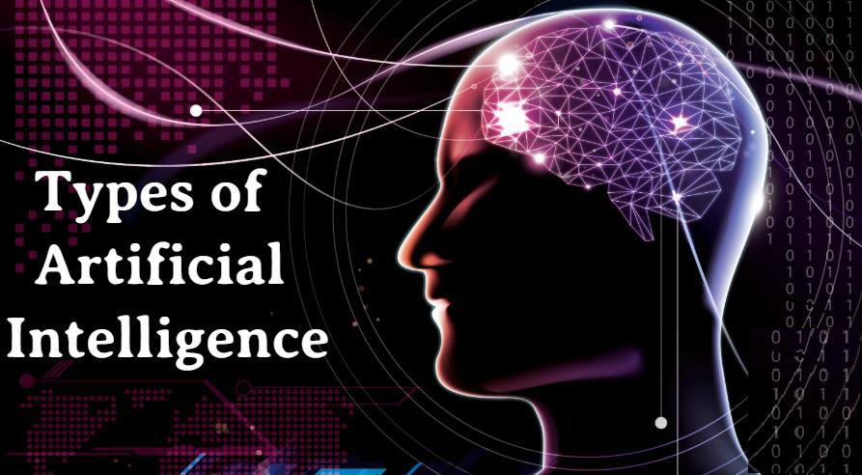

Slide 36
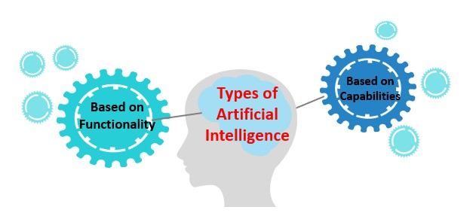
TYPES OF ARTIFICIAL INTELLIGENCE
The main aim of Artificial Intelligence aim is to enable machines to perform a human-like function
Artificial Intelligence can be divided in various types, there are mainly two types of main categorization which are based on capabilities and based on functionally of AI.

Slide 37
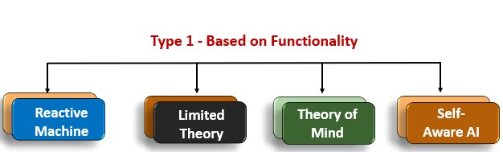
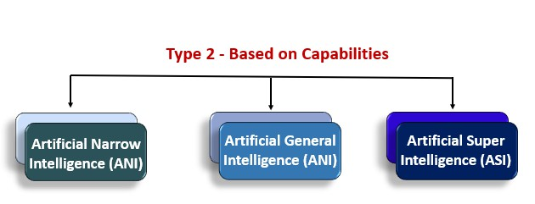

Slide 38
BASED ON FUNCTIONALITY
REACTIVE MACHINES
Purely reactive machines are the most basic types of Artificial Intelligence.
Such AI systems do not store memories or past experiences for future actions.
These machines only focus on current scenarios and react on it as per possible best action.
IBM's Deep Blue system is an example of reactive machines.
Google's AlphaGo is also an example of reactive machines.
LIMITED MEMORY
Limited memory machines can store past experiences or some data for a short period of time.
These machines can use stored data for a limited time period only.
Self-driving cars are one of the best examples of Limited Memory systems. These cars can store recent speed of nearby cars, the distance of other cars, speed limit, and other information to navigate the road.

Slide 39
3. THEORY OF MIND
Theory of Mind AI should understand the human emotions, people, beliefs, and be able to
interact socially like humans.
This type of AI machines are still not developed, but researchers are making lots of efforts and improvement for developing such AI machines.
SELF-AWARENESS
Self-awareness AI is the future of Artificial Intelligence. These machines will be super intelligent, and will have their own consciousness, sentiments, and self-awareness.
These machines will be smarter than human mind.
Self-Awareness AI does not exist in reality still and it is a hypothetical concept.

Slide 40
BASED ON CAPABILITIES
WEAK AI OR NARROW AI:
Narrow AI cannot perform beyond its field or limitations, as it is only trained for one specific task. Hence it is also termed as weak AI. Narrow AI can fail in unpredictable ways if it goes beyond its limits.
Apple Siriis a good example of Narrow AI, but it operates with a limited pre-defined range of functions.
IBM's Watson supercomputer also comes under Narrow AI, as it uses an Expert system approach combined with Machine learning and natural language processing.
Some Examples of Narrow AI are playing chess, purchasing suggestions on e-commerce site,
self-driving cars, speech recognition, and image recognition.

Slide 41
2. GENERAL AI:
General AI is a type of intelligence which could perform any intellectual task with efficiency
like a human.
The idea behind the general AI to make such a system which could be smarter and think like a human by its own.
Currently, there is no such system exist which could come under general AI and can perform any task as perfect as a human.
The worldwide researchers are now focused on developing machines with General AI.
As systems with general AI are still under research, and it will take lots of efforts and time to develop such systems.

Slide 42
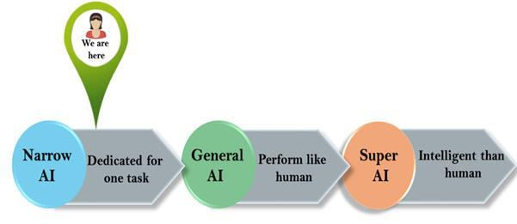
SUPER AI:
Super AI is a level of Intelligence of Systems at which machines could surpass human intelligence, and can perform any task better than human with cognitive properties. It is an outcome of general AI.
Some key characteristics of strong AI include capability include the ability to think, to reason, solve the puzzle, make judgments, plan, learn, and communicate by its own.
Super AI is still a hypothetical concept of Artificial Intelligence. Development of such systems in real is still world changing task.

Slide 43
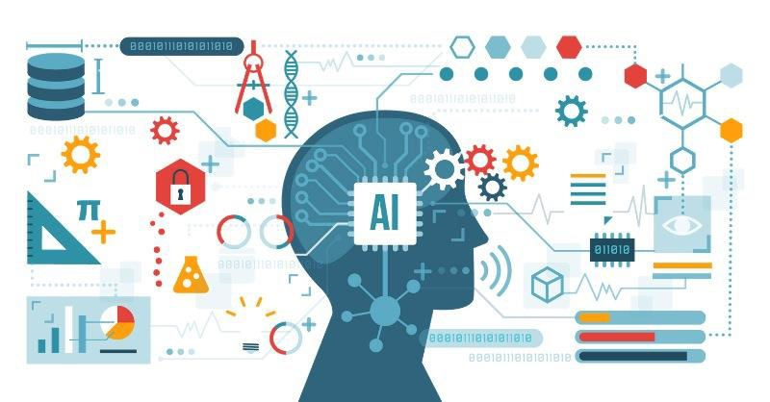
BENEFITS OF ARTIFICIAL INTELLIGENCE

Slide 44
BENEFITS OF ARTIFICIAL INTELLIGENCE
INCREASED EFFICIENCY
REDUCING HUMAN RISK
AID IN DECISION MAKING
AVAILABILITY
1. INCREASED EFFICIENCY
Machines are highly efficient in contrast to the human workforce. This is because they can complete monotonous tasks effectively without taking a break and irrespective of the working conditions.
Take the example of Power BI. Earlier, time was spent in sifting, isolating, and utilizing the information in MS Excel, Power BI utilizes AI to do the entirety of this (and significantly more) autonomously.
This expands the effectiveness of the framework and spares significant time for the investigator to utilize
it somewhere else.

Slide 45
REDUCING HUMAN RISK
A lot of places wherein it is hazardous for a person to be truly present.
Man-made brainpower can be useful in such cases since it would empower the machines to have the option to settle on choices continuously. A case of this is a remote ocean boring at the sea bed where there is a high danger of human life.
AID IN DECISION MAKING
This is the domain where AI has successfully paid dividends. AI has the capacity to analyze a great deal of information in a brief time frame. This is helping people improve decision making. Take the case of an investor who needs to conclude whether to give out a credit or not.
This can be highly effective in verticals like portfolio management. This would help in a more astute and quicker dynamic for the investor.

Slide 46
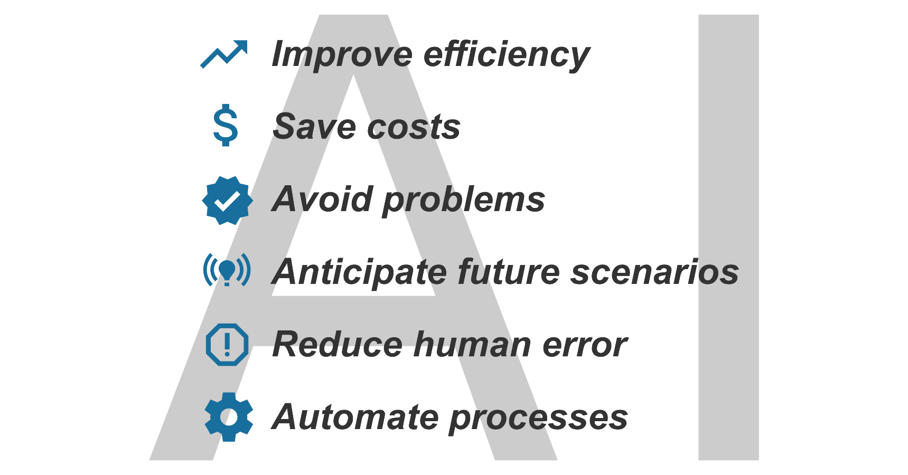
4. AVAILABILITY
Machines, in contrast to people, don’t have to take rests. They can work nonstop.
Now, we can depend on machines for keeping up required manufacturing units running with their judgment which would prompt 24×7 creation units and complete mechanization.

Slide 47

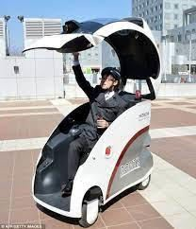
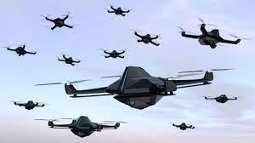
ROBOTIC VEHICLES: A driverless robotic car named STANLEY sped through the rough terrain of the Mojave Desert at 22 mph, finishing the 132-mile course first to win the 2005 DARPA Grand Challenge.
STANLEY is a Volkswagen Touareg outfitted with cameras, radar, and laser rangefinders to sense the environment and onboard software to command the steering, braking, and acceleration (Thrun,
2006).
The following year CMU’s BOSS won the Urban Challenge, safely driving in traffic through the
streets of a closed Air Force base, obeying traffic rules and avoiding pedestrians and other vehicles.

Slide 48
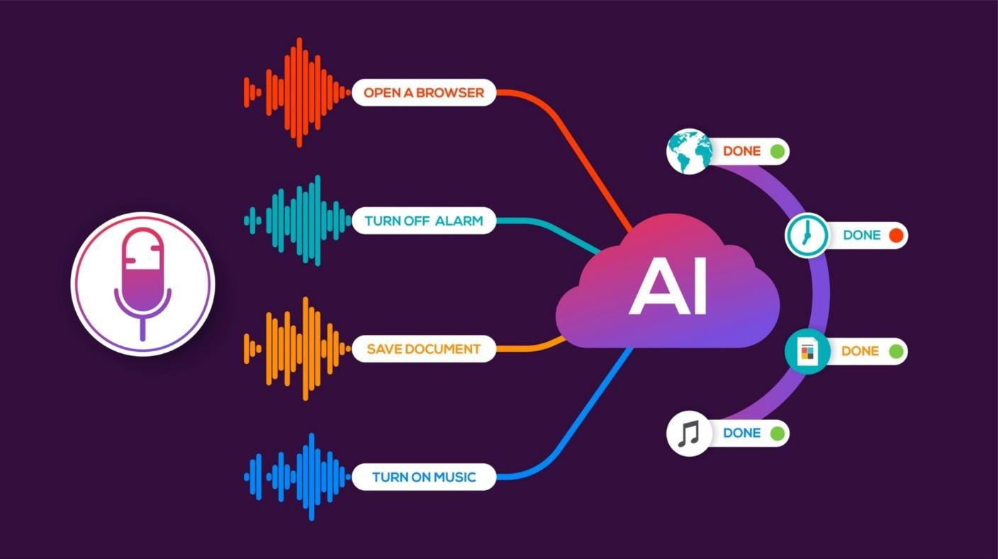
SPEECH RECOGNITION: A traveller calling United Airlines to book a flight can have the entire
conversation guided by an automated speech recognition and dialog management system.

Slide 49
AGENTS
AND
ENVIRONMENTS

Slide 50
AGENTS AND ENVIRONMENTS
Agents in Artificial Intelligence are the associated concepts that the AI technologies work upon.
The AI software or AI-enabled devices with sensors generally captures the information from
the environment setup and process the data for further actions.
There are mainly two ways the agents interact with the environment, such as perception and
action.
The person is only passive for capturing the information without changing the actual environment, whereas action is the active form of interaction by changing the actual environment.
AI technologies such as virtual assistance catboats, AI-enabled devices to work based on the
previous persecution data processing and learning for the actions.

Slide 51
WHAT IS AN AGENT?
An Agent is anything that takes actions according to the information that it gains from the environment.
HUMAN-AGENT: A human agent has eyes, ears, and other organs which work for sensors and
hand, legs, vocal tract work for actuators.
ROBOTIC AGENT: A robotic agent can have cameras, infrared range finder, NLP for sensors and various motors for actuators.
SOFTWARE AGENT: Software agent can have keystrokes, file contents as sensory input and act on those inputs and display output on the screen.

Slide 52
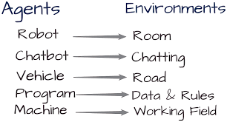
EXAMPLE FOR AGENT AND ENVIRONMENTS?

Slide 53
HOW DOES THE AGENT INTERACT WITH THE ENVIRONMENT?
The agents interact with the environment in two ways:
PERCEPTION
Perception is a passive interaction, where the agent gains information about the environment without changing the environment. The sensors of the robot help it to gain information about the surroundings without affecting the surrounding. Hence, gaining information through sensors is called perception.
ACTION
Action is an active interaction where the environment is changed. When the robot moves an obstacle using its arm, it is called an action as the environment is changed. The arm of the robot is called an “Effector” as it performs the action.

Slide 54
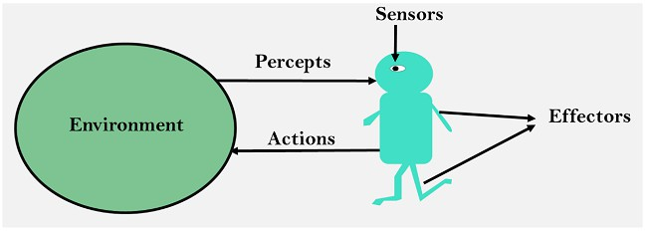
SENSOR: Sensor is a device which detects the change in the environment and sends the information to other electronic devices. An agent observes its environment through sensors.
ACTUATORS: Actuators are the component of machines that converts energy into motion. The actuators are only responsible for moving and controlling a system. An actuator can be an electric motor, gears, rails, etc.
EFFECTORS: Effectors are the devices which affect the environment. Effectors can be legs, wheels, arms, fingers, wings, fins, and display screen.

Slide 55

CONSIDER A VACUUM CLEANER WORLD
Imagine that our intelligent agent is a robot vacuum cleaner.
Let's suppose that the world has just two rooms. The robot can be in either room and there can be dirt in zero, one, or two rooms.

Slide 56
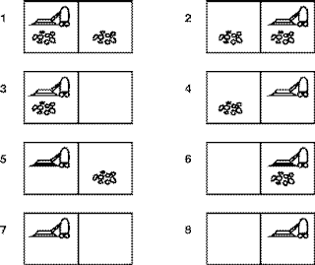

Slide 57
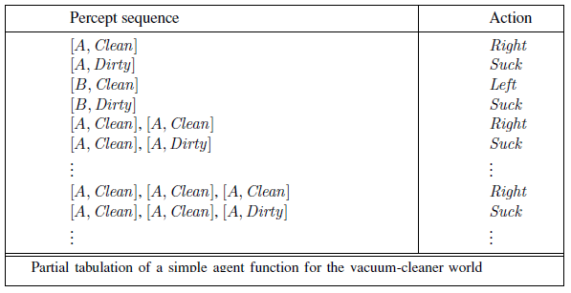

Slide 58
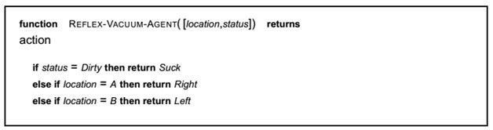
MEASURING PERFORMANCE
With any intelligent agent, we want it to find a (good) solution and not spend forever doing it.
The interesting quantities are, therefore,
THE SEARCH COST--how long the agent takes to come up with the solution to the problem,
and
THE PATH COST--how expensive the actions in the solution are. The total cost of the solution is the sum of the above two quantities.

Slide 59
HOW SHOULD THE AGENTS ACT IN ARTIFICIAL INTELLIGENCE?
A rational agent does the right thing. The right action is the one that causes the agent to be the
most successful.
An omniscient agent knows what impact the action will have and can act accordingly, but it is not possible in reality.
The degree of success which is defined by the performance measure
The percept sequence which is the entire sequence of perceptions by the agent until the present
moment
Agent Type | Percepts | Action | Goals | Environment
Car Driver | Speedometer, GPS, Microphone, Cameras | Steering control, accelerate, brake, talk to passenger | Safe, legal, comfortable journey | Road, Traffic, Pedestrian etc.

Slide 60
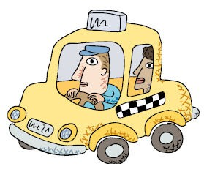
PEAS: SPECIFYING AN AUTOMATED TAXI DRIVER
Performance measure: ? Environment: ?
Actuators: ? Sensors: ?
Performance measure:
safe, fast, legal, comfortable, maximize profits
Environment:
roads, other traffic, pedestrians, customers
Actuators:
steering, accelerator, brake, signal, horn
Sensors:
cameras, sonar, speedometer, GPS

Slide 61
PEAS: MEDICAL DIAGNOSIS SYSTEM
PERFORMANCE MEASURE: Healthy patient, minimize costs, lawsuits
ENVIRONMENT: Patient, hospital, staff
ACTUATORS: Screen display (form including: questions, tests, diagnoses, treatments, referrals)
SENSORS: Keyboard (entry of symptoms, findings, patient's answers)

Slide 62
THE NATURE OF
ENVIRONMENTS

Slide 63
THE NATURE OF ENVIRONMENTS
An environment in artificial intelligence is the surrounding of the agent. The agent takes
input from the environment through sensors and delivers the output to the environment through actuators.
An environment is everything in the world which surrounds the agent, but it is not a part of an agent itself.
An environment can be described as a situation in which an agent is present.
The environment is where agent lives, operate and provide the agent with something to sense and act upon it.

Slide 64
FEATURES OF ENVIRONMENT
As per Russell and Norvig, an environment can have various features from the point of view of an agent:
Fully observable vs Partially Observable
Static vs Dynamic
Discrete vs Continuous
Deterministic vs Stochastic
Single-agent vs Multi-agent
Episodic vs sequential
Known vs Unknown
Accessible vs Inaccessible

Slide 65
FULLY OBSERVABLE VS PARTIALLY OBSERVABLE:
If an agent sensor can sense or access the complete state of an environment at each point of time
then it is a fully observable environment, else it is partially observable.
A fully observable environment is easy as there is no need to maintain the internal state to keep track history of the world.
An agent with no sensors in all environments then such an environment is called as unobservable.
DETERMINISTIC VS STOCHASTIC:
If an agent's current state and selected action can completely determine the next state of the environment, then such environment is called a deterministic environment.
A stochastic environment is random in nature and cannot be determined completely by an agent.
In a deterministic, fully observable environment, agent does not need to worry about uncertainty.

Slide 66
EPISODIC VS SEQUENTIAL:
In an episodic environment, there is a series of one-shot actions, and only the current percept is
required for the action.
However, in Sequential environment, an agent requires memory of past actions to determine the next best actions.
SINGLE-AGENT VS MULTI-AGENT
If only one agent is involved in an environment, environment is called single agent environment.
and operating by itself then such an
However, if multiple agents are operating in an environment, then such an environment is called
a multi-agent environment.
The agent design problems in the multi-agent environment are different from single agent environment.

Slide 67
STATIC VS DYNAMIC:
If the environment can change itself while an agent is deliberating then such environment is
called a dynamic environment else it is called a static environment.
Static environments are easy to deal because an agent does not need to continue looking at the world while deciding for an action.
However for dynamic environment, agents need to keep looking at the world at each action.
Taxi driving is an example of a dynamic environment whereas Crossword puzzles are an example of a static environment.

Slide 68
DISCRETE VS CONTINUOUS:
If in an environment there are a finite number of percepts and actions that can be performed within it, then such an environment is called a discrete environment else it is called continuous environment.
A chess game comes under discrete environment as there is a finite number of moves that can be performed.
A self-driving car is an example of a continuous environment.
7. ACCESSIBLE VS INACCESSIBLE
If an agent can obtain complete and accurate information about the state's environment, then such
an environment is called an Accessible environment else it is called inaccessible.
An empty room whose state can be defined by its temperature is an example of an accessible environment.

Slide 69
8. KNOWN VS UNKNOWN
Known and unknown are not actually a feature of an environment, but it is an agent's state of
knowledge to perform an action.
In a known environment, the results for all actions are known to the agent. While in unknown
environment, agent needs to learn how it works in order to perform an action.
It is quite possible that a known environment to be partially observable and an Unknown environment to be fully observable.

Slide 70
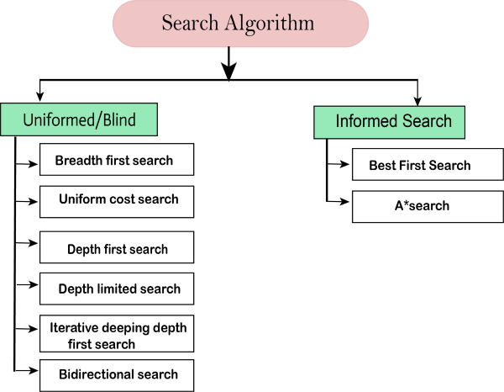
TYPES OF SEARCH ALGORITHMS
Based on the search problems we can classify the search algorithms into uninformed (Blind search)
search and informed search (Heuristic search) algorithms.

Slide 71
UNINFORMED/BLIND SEARCH:
The uninformed search does not contain any domain knowledge such as closeness, the location of
the goal. It operates in a brute-force way as it only includes information about how to traverse the tree
and how to identify leaf and goal nodes.
Uninformed search applies a way in which search tree is searched without any information about the search space like initial state operators and test for the goal, so it is also called blind search. It examines each node of the tree until it achieves the goal node.
It can be divided into five main types:
Breadth-first search
Uniform cost search
Depth-first search
Iterative deepening depth-first search
Bidirectional Search

Slide 72
BREADTH-FIRST SEARCH:-
Breadth-first search is the most common search strategy for traversing a tree or graph.
This algorithm searches breadthwise in a tree or graph, so it is called breadth-first search.
BFS algorithm starts searching from the root node of the tree and expands all successor node at the current level before moving to nodes of next level.
Breadth-first search implemented using FIFO queue data structure.
ADVANTAGES:
BFS will provide a solution if any solution exists.
If there are more than one solution for a given problem, then BFS will provide the minimal solution
which requires the least number of steps.

Slide 73
2. DEPTH-FIRST SEARCH
Depth-first search is a recursive algorithm for traversing a tree or graph data structure.
It is called the depth-first search because it starts from the root node and follows each path to its
greatest depth node before moving to the next path.
DFS uses a stack data structure for its implementation.
The process of the DFS algorithm is similar to the BFS algorithm.
ADVANTAGE:
DFS requires very less memory as it only needs to store a stack of the nodes on the path from root node to the current node.
It takes less time to reach to the goal node than BFS algorithm (if it traverses in the right path).
DISADVANTAGE:
There is the possibility that many states keep re-occurring, and there is no guarantee of finding the solution.
DFS algorithm goes for deep down searching and sometime it may go to the infinite loop.

